Slide 1
ESFP-2 PROJECT STAFF GRIEVANCE MANAGEMENT SYSTEM

Slide 2
LIBRARIES Used
The libraries which are used in this project of STAFF GRIEVANCE MANAGEMENT SYSTEM are as follows :
1. #include<iostream>
2. #include<fstream>
3.#include<cstring>
4.#include<iomanip>

Slide 3
Member functions used are :
Functions used are :
int setsid()
int setgid()
void getd()
void putd()
void getdata()
void putdata()

Slide 4
In getd(), we input the details of staff i.e. Staff_Id, Name, Work Experience and Work Domain.In putd(), we display the details enter ed by user.

Slide 5
Algorithm
Following are the steps of the algorithm :
STEP 1: Declare 2 classes named as staff and grievance.
STEP 2 : Declare function setsid() ,getd() , putd() in class staff to return id, store details and view details respectively.
STEP 3: In main() function create an array of object of the class and call the function to store the details of the class.
Step 4 : Display the details according to which member is performing the task.
Step 5 : Create an object of ofstream file to write onto the file with ios::out mode.
Step 6 :Create an object of ofstream file to append record with ios::app mode.
Step 7 :Create an object of ifstream file to read from the file and display the record.

Slide 6
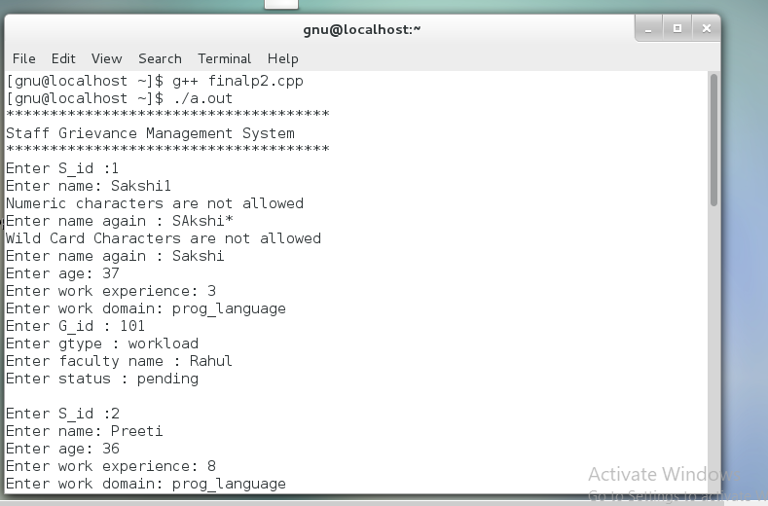
Enter the details :

Slide 7
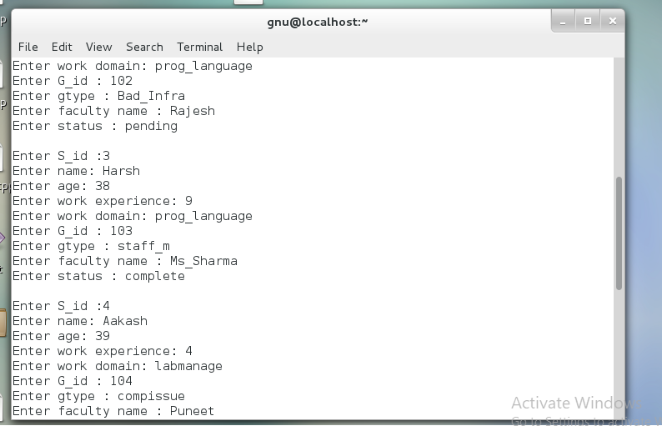
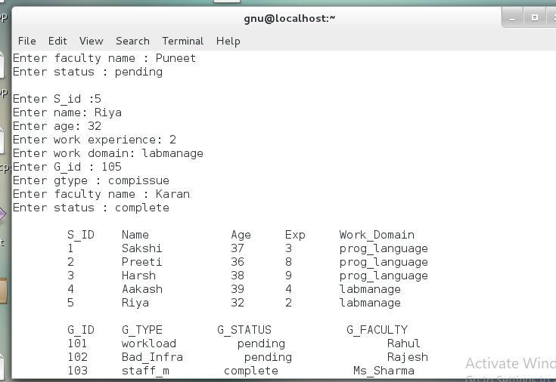

Slide 8
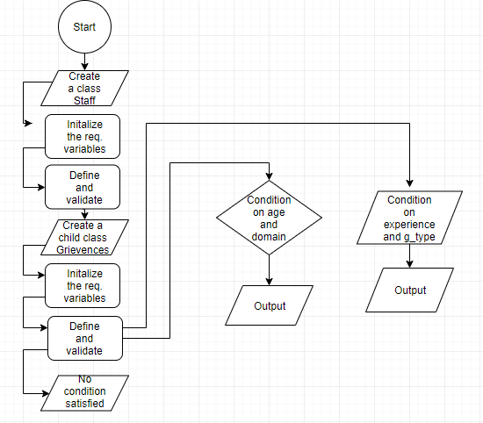
Dhruv’s flowchart

Slide 9
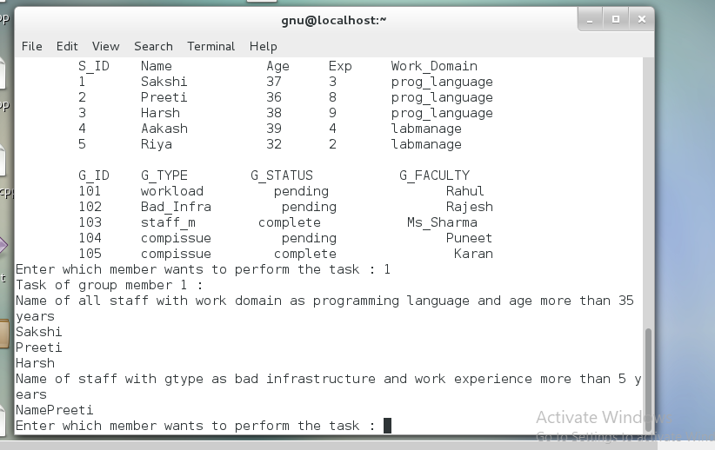
Task of member 1 :

Slide 10
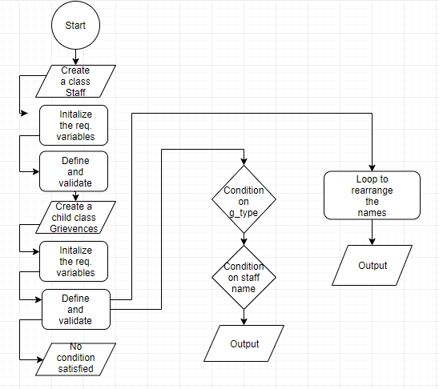
Dhyeya’s flowchart

Slide 11
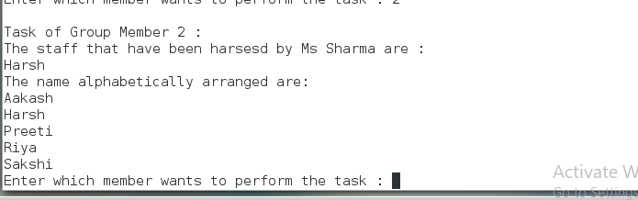
Task of member 2 :

Slide 12
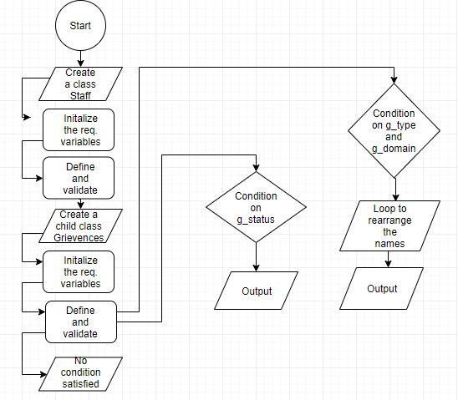
Drishti ‘s Flowchart

Slide 13
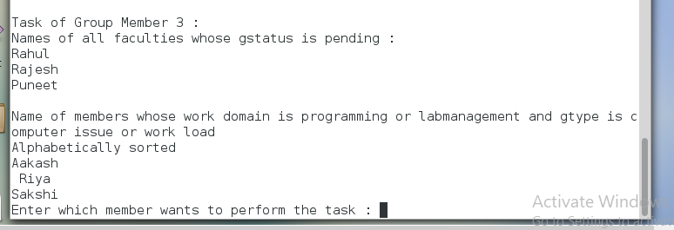
Task of member 3 : Display the name of all faculties whose gstatus is pending. Display staff members with work domain as programming language or labmanagement and gtype as computer issue or work load(Alphabetically Sorted).

Slide 14
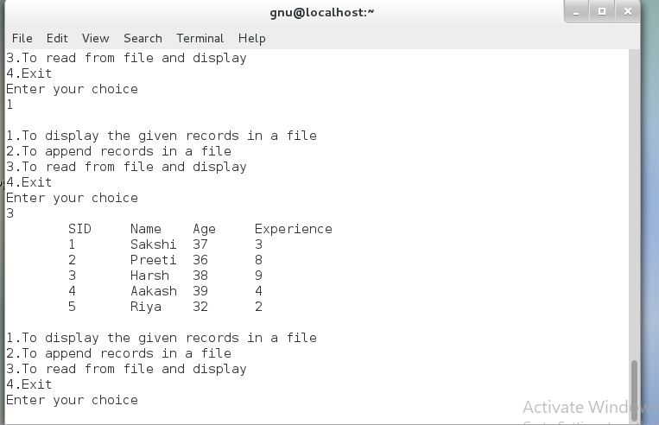
To display the records in the file :

Slide 15
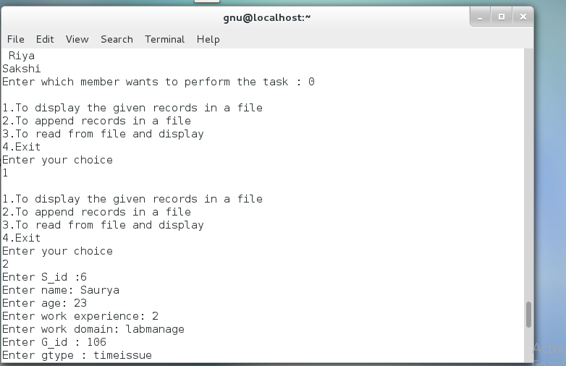
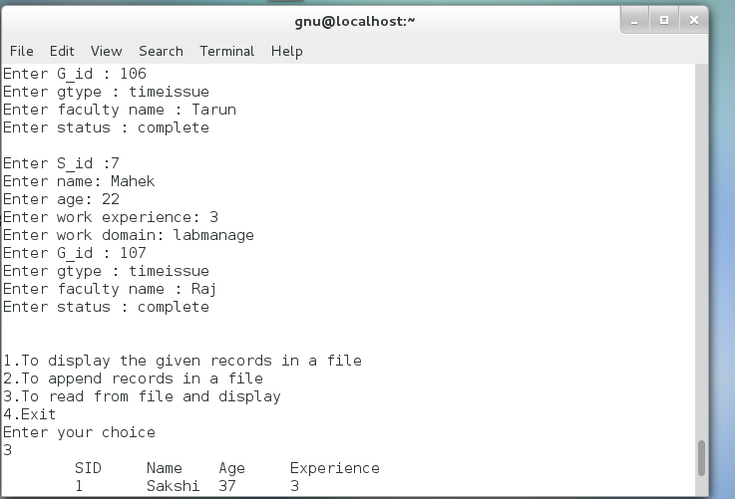
To append records :

Slide 16
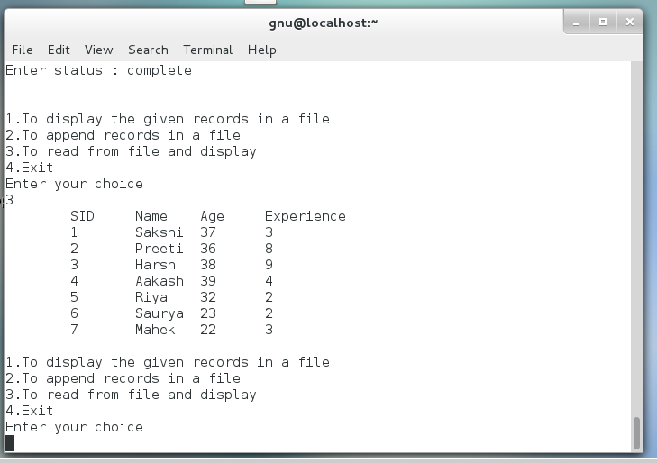
To display records :

Slide 17
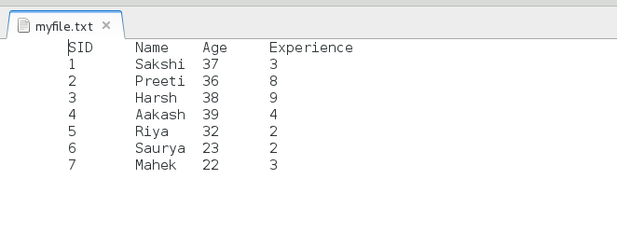

Slide 18
THANK YOU.
Presented by:
Dhruv Dasadia : 18162121005
Dhyeya Vyas : 18162121006
Drishti Patel : 18162121007

